Slide 1
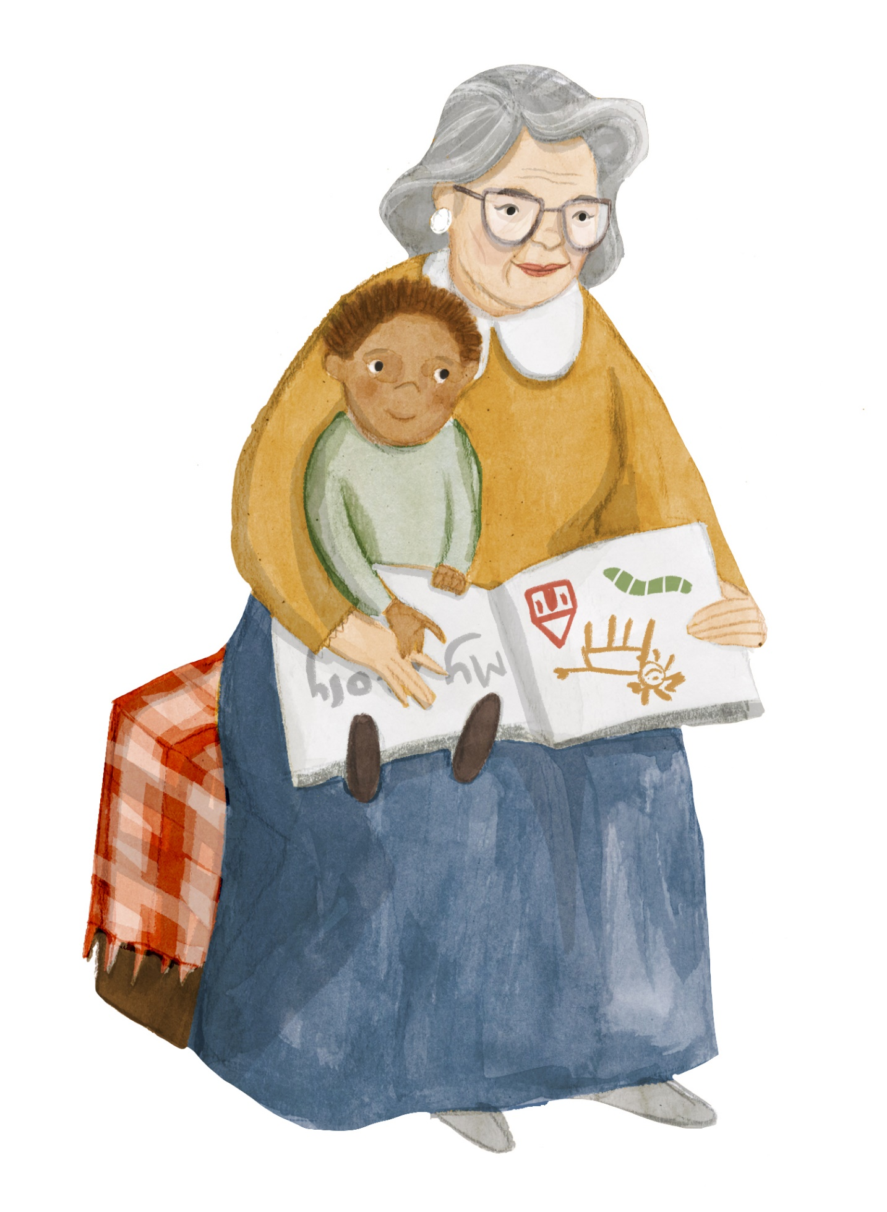
The Nature of Home 1 What is a home?
PSHE

Slide 2
What is a home? Session one: PSHE
Learners will be able to:
Describe what home means to them using their five senses
Express gratitude for the things in their lives that make them feel ‘at home’
Compare their lives to the lives of other children from different places and cultures and recognise both their ‘common humanity’ and diversity

Slide 3
Key words
 | Definition | Synonyms
Home | A place where you live or feel comfortable and feel a sense of belonging | Abode, sanctuary, shelter
Belonging | A sense of being accepted, fitting in or being connected with others or a place | Attachment, acceptance, affinity
Wellbeing | A sense of happiness, health and meaning | Welfare
Gratitude | Recognition and thankfulness for the good things in our lives and the things that others do for us | Appreciation, gratefulness
Symbol | A thing that represents or stands for something else, because it is connected with it in our minds | Representation, reflection
Similarity | The state of being alike or having things in common | Affinity, connection, commonality
Difference | Ways in which two things are not the same | Contrast, diversity

Slide 4
What does home mean to me? Engage walk
Walk around the room/playground in your Learning Trio looking at the pictures. Discuss the following questions using the talk planner to help you formulate your responses.
Which picture most symbolises home to you? Why?
Which picture are you most drawn to? Why?
Choosing one of the pictures, what emotions does it create in you? Why do you think that is?
Notes:
Engage walk – approximately 5 minutes
Children walk around the room/playground in Learning Trio looking at the pictures. They discuss the questions using the talk planner to help formulate their responses.
Pitstop: responding to other people’s ideas – discuss top tips for showing respect and kindness when sharing personal ideas –eg Wow – I would never have thought of it like that! What an interesting/ unique idea!
Differentiation: Mixed ability trios and use of talk planner to support less able and challenge more able by extending vocabulary

Slide 5
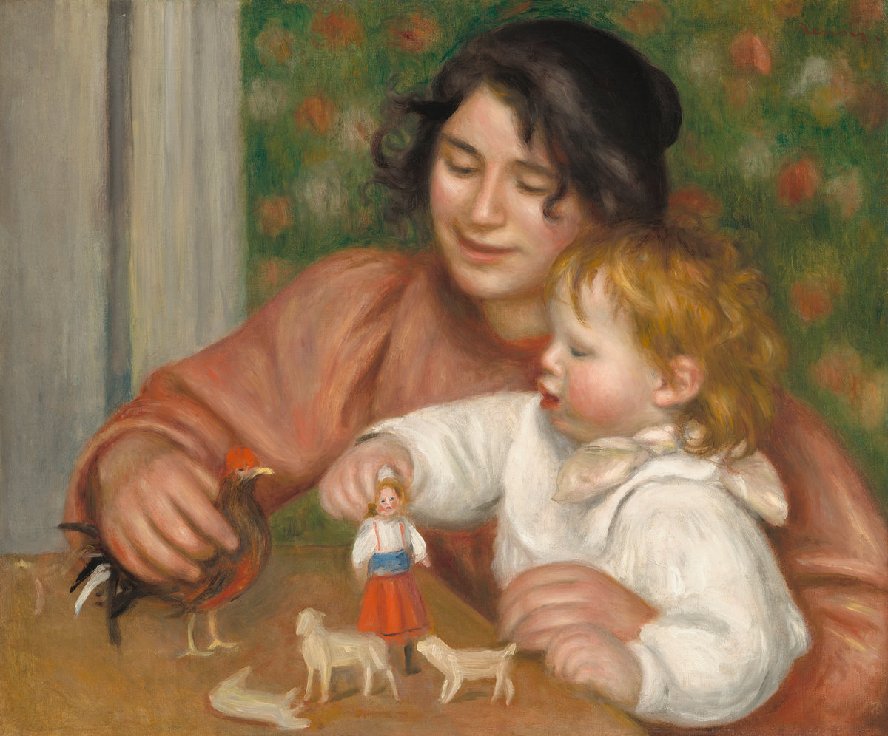
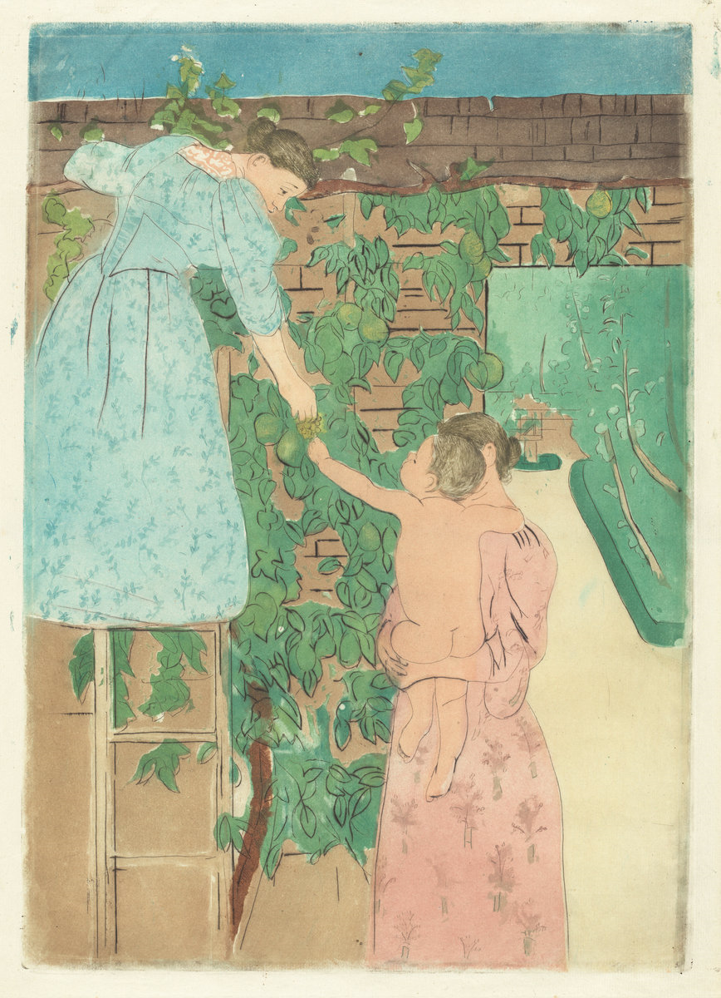
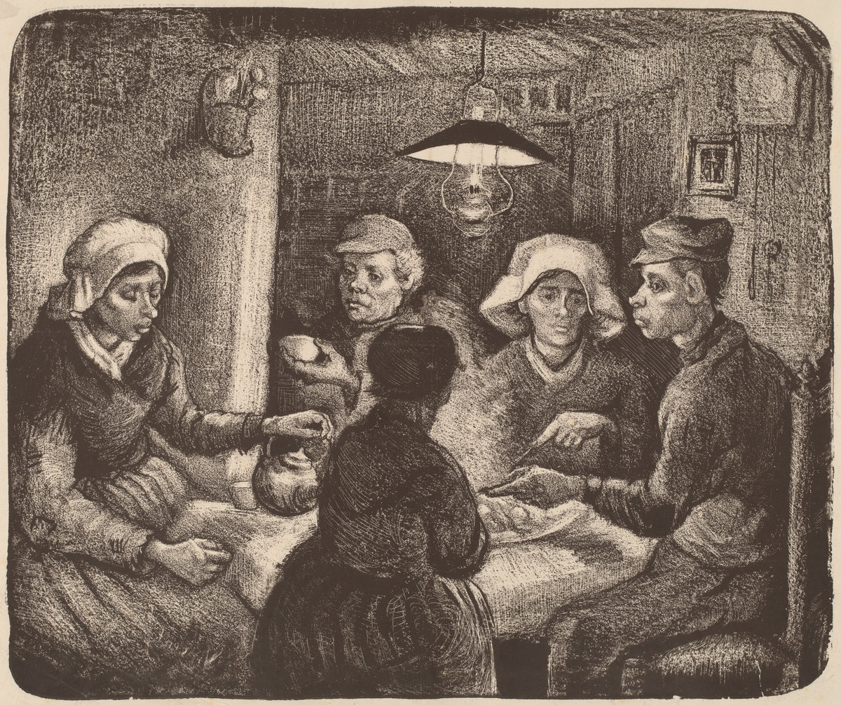
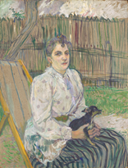
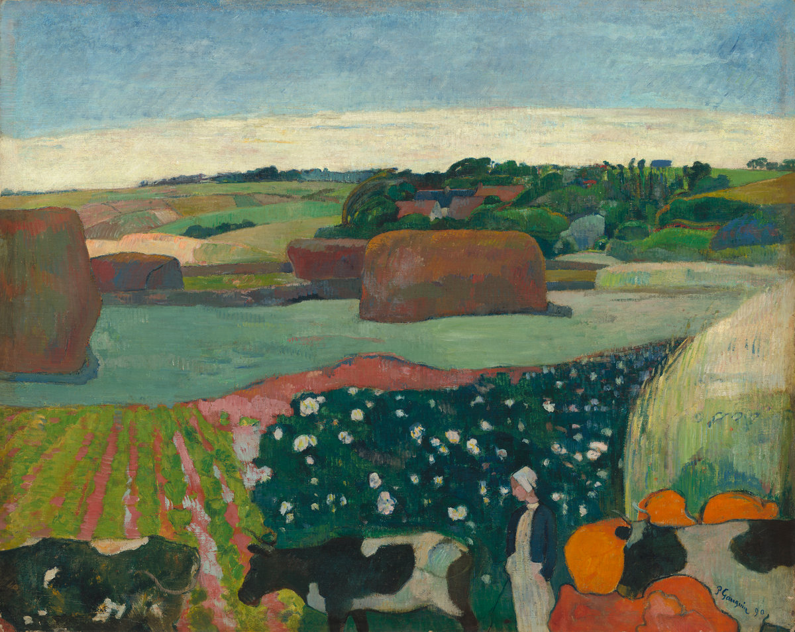
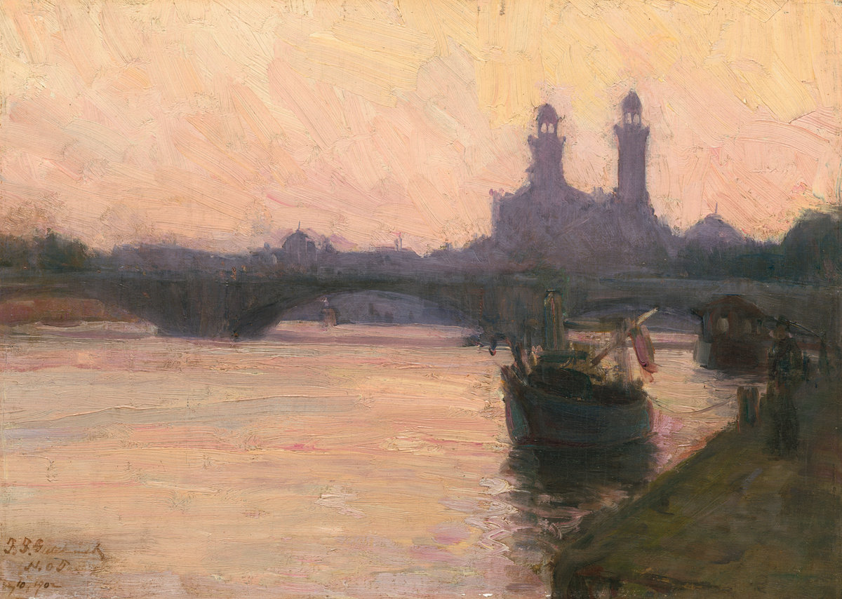
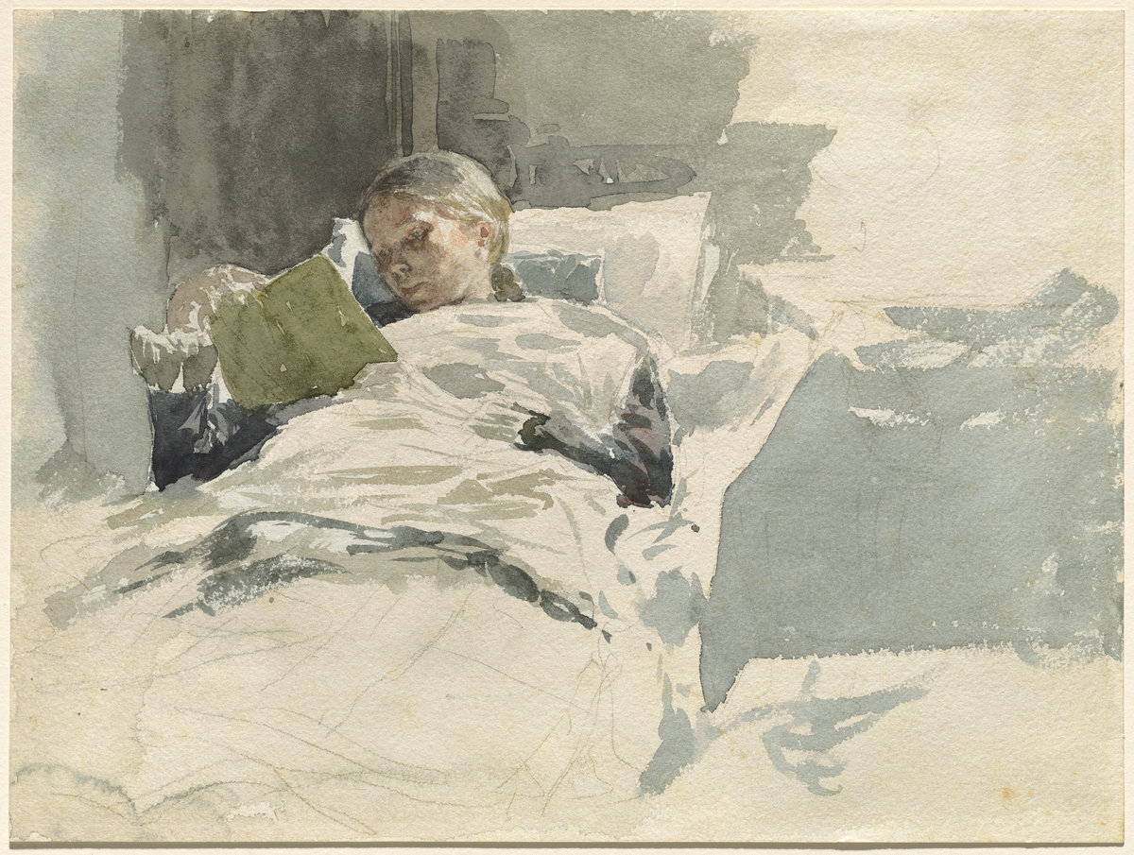
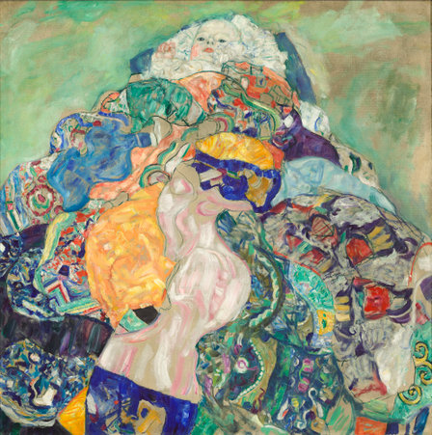
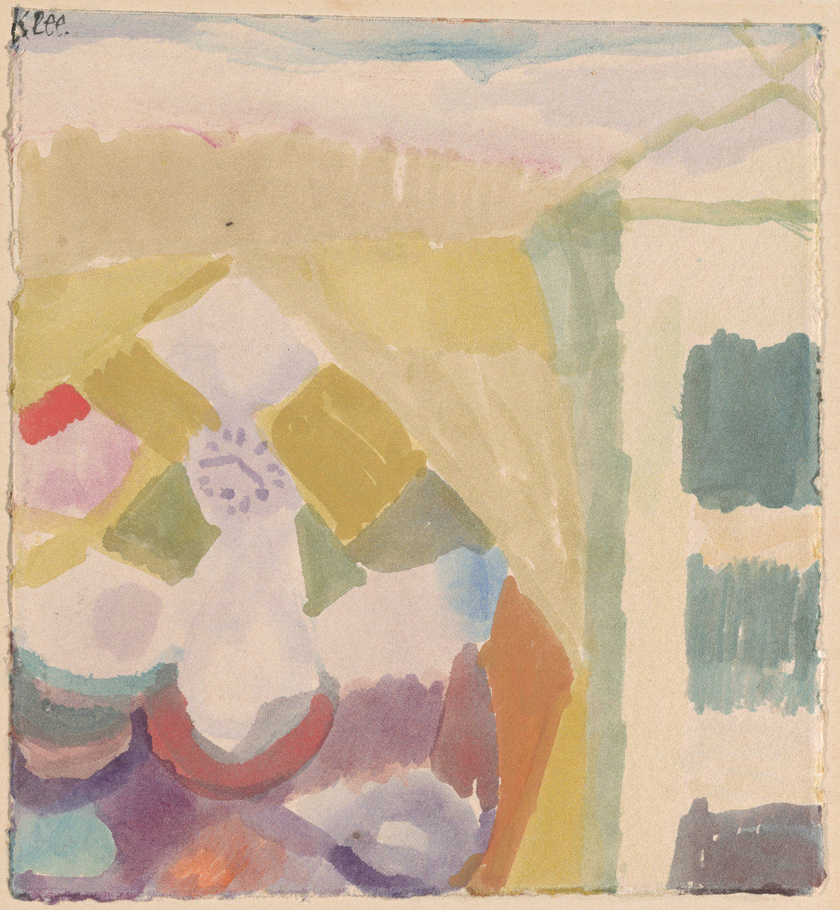
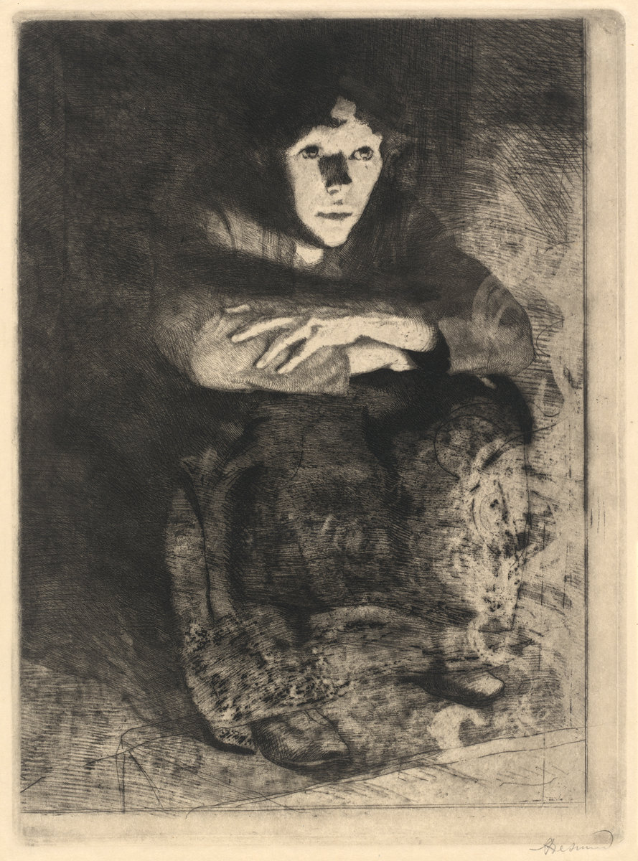
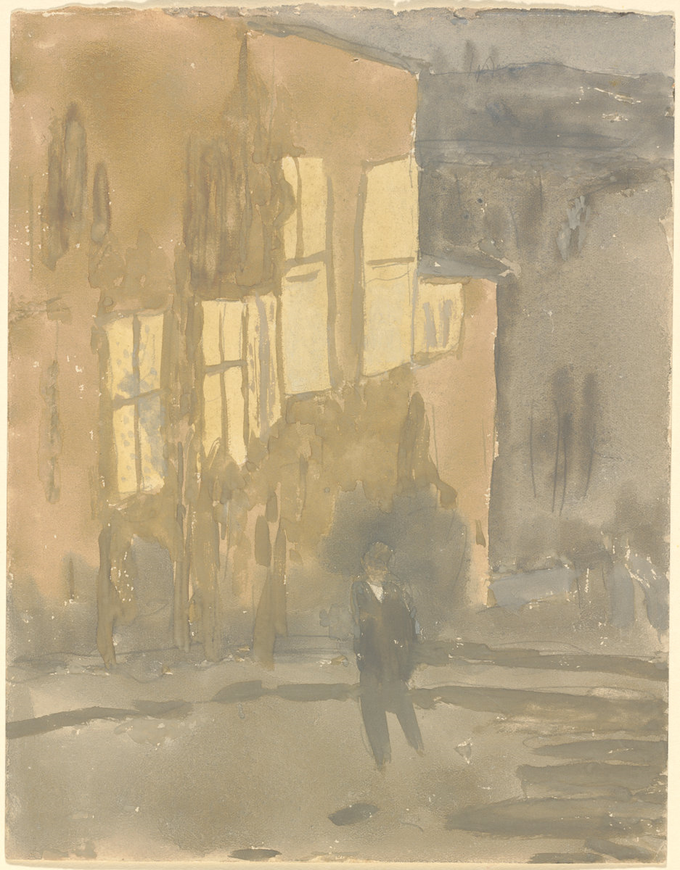
Notes:
Image top row left to right:
Child with Toys - Gabrielle and the Artist's Son, Jean, Auguste Renoir, 1895-1896
Gathering Fruit, Mary Cassatt, 1893
Lady with a Dog, Henri de Toulouse-Lautrec, 1891
Potato Eaters, Vincent Van Gogh, 1885
Images middle row left to right:
Haystacks in Brittany, Paul Gauguin, 1890
The Seine, Henry Ossawa Tanner, 1902 (the first African-American painter to gain international recognition)
The Artist's Wife Reading in Bed, Leopold von Kalckreuth, 1885-1890
Images bottom row left to right:
Baby (Cradle), Gustav Klimt, 1917-1918
Interieur mit der Uhr, Paul Klee, 1913
In The Embers, Albert Besnard, 1887
Street at Night, Meudon, Gwen John, 1910s (a painter over-shadowed by her brother, also a painter, during her life and largely forgotten after her death, Gwen John was recognised in the 21st century as one of the foremost artists of the post-impressionist period)
These images are contemporary to the period studied in the following sessions. They are available on an open access policy from https://images.nga.gov/en/page/openaccess.html.
Please feel free to add or substitute your own choice of pictures.

Slide 6
What does home mean to me? Talk planner
I chose this intriguing picture because……
In my opinion, this is the picture that most symbolises home to me because…
Surprisingly, the picture that most reflects my sense of home is….
In addition, the picture conjures up images of……
Furthermore, I am drawn to the picture due to its……

Slide 7
What does home mean to me? Teacher’s Bag of Home
My Bag of Home:
Sight
Smell
Taste
Touch
Sound
Feel inside
Notes:
Teacher input – approximately 5 minutes
My bag of home - teacher to share some objects that remind them of home linked to five senses.
Here are some examples:
Candle (smell) – calm space where I can relax (at my house, when on holiday, at yoga, at friend’s houses)
Shell (sight) – reminds me of the sea and I feel most alive by the sea and spent many happy times there with family
Beatles Here Comes the Sun song (sound) – reminds me of my dad and happy holidays, not to mention my wedding song
Teddy (touch) – take anywhere you go and reminds of happy childhood memories and trips to Disney with my family
Pasta (taste) – comforting food
Family photo (feel inside) – I feel my most happy and at home when I’m with my children

Slide 8
What does home mean to me? My Bag of Home
Now draw your own Bag of Home:
Sight
Smell
Taste
Touch
Sound
Feel inside
Notes:
Independent thinking – approximately 5 minutes
Children draw their own Bag of Home using the five senses (they can add more than one object per sense)

Slide 9
What does home mean to me? Poem
Use your Bag of Home to write a poem about what home means to you. If you need help, use the following structure:
Home looks like….
Home smells like….
Home tastes like….
Home feels like ….
Home sounds like….
Before you start, explore the poems written last year by children in Harpenden, UK, and Jinga, Uganda....
Notes:
Independent writing – approximately 20 minutes
Encourage children to extend their ideas with figurative language and expanded noun phrases
Show example poems of child from Harpenden and a child from Jinja, Uganda –see next slide. What is the same and what is different? In what way is a child in Jinja similar to you? Different from you?

Slide 10
A child’s home poem: Harpenden
Home smells like fresh mangoes sliced into squares,
Like a scented candle glowing and warming my heart.
Home tastes like hot chocolate on a cold winter’s morning,
A bowl of goulash homemade in our very own yard.
Home sounds like the pitter-patter of rain on a frosty window pane,
The sound of birds chirping cheerfully to each other.
Home feels like a fresh flower blossoming in the woods,
A new-made teddy bear close to my heart.
Home looks like a fresh-flowing river galloping,
A funny Youtube video watched with my family.
I love my home.
Digby, Harpenden
Notes:
Teacher input – approximately 15 minutes
Explain that the children will use their Bag of Home to write a poem about home.
Read and discuss the examples from children in Harpenden and Jinja.
Guiding questions:
What do you like about the poem?
What strikes you about the poem?
What questions do you have about the poem or the poet?
What is the same about the poems? What is different?
In what ways do the children in Jinja have a similar understanding of home to you? How is it different?
In what ways are all children similar? Different?

Slide 11
A child’s home poem: Harpenden
Home is a fragile flame
that can’t be put out.
Home sounds like my Dad
telling awful jokes.
Home tastes like cookies,
brownies, anything sweet.
Home looks like a TV
because me and my mum
always watch Saturday night TV together.
Home sounds like people laughing, smiling.
Home can be big or small, tiny or tall.
Home can look like anything.
Rosie, Harpenden
Notes:
Teacher input – approximately 15 minutes
Explain that the children will use their Bag of Home to write a poem about home.
Read and discuss the examples from children in Harpenden and Jinja.
Key questions:
What do you like about the poem?
What strikes you about the poem?
What questions do you have about the poem or the poet?
What is the same about the poems? What is different?
In what way is a child in Jinga similar to you? Different from you?
In what way are all children similar? Different?

Slide 12
A child’s home poem: Jinja
This is a mango tree on our compound at home.
When I am hungry after school I come home
and take one from the tree.
It is also where I hang out
with my friends and climb.
We use the tree as shelter to eat under.
Mother cooks under the tree using fire.
She cooks rice or millet flour.
The fire is family time,
we sit round it and tell stories.
The fire reminds me of warmth and home.
Timothy
Notes:
Teacher input – approximately 15 minutes
Explain that the children will use their Bag of Home to write a poem about home.
Read and discuss the examples from children in Harpenden and Jinja.
Key questions:
What do you like about the poem?
What strikes you about the poem?
What questions do you have about the poem or the poet?
What is the same about the poems? What is different?
In what way is a child in Jinga similar to you? Different from you?
In what way are all children similar? Different?

Slide 13
Children’s home poems: Jinja, Uganda
Home smells like flowers
Home sounds very quiet
I come from a place where lots of bananas are grown
I come from a place with plants everywhere
Home tastes like fruit of many kinds
Home feels peaceful
I come from a place surrounded by mangoes
I come from a place where bananas are grown - very yellow!
Children of Kyabato School, Jinja
Home means a house
where I can sleep and
be safe from snakes.
It also protects you from
night dancers.
Home means a sheltered
place to sleep.
Sumini, Jinja
Notes:
Teacher input – approximately 15 minutes
Explain that the children will use their Bag of Home to write a poem about home.
Read and discuss the examples from children in Harpenden and Jinja.
Key questions:
What do you like about the poem?
What strikes you about the poem?
What questions do you have about the poem or the poet?
What is the same about the poems? What is different?
In what way is a child in Jinga similar to you? Different from you?
In what way are all children similar? Different?

Slide 14
What does home mean to us all?
How is the meaning of home similar for children in Harpenden and Jinja?
How is it different?
Are there some meanings of home that are shared by everyone, everywhere?
Notes:
Discussion – approximately 5 minutes

Slide 15
What does home mean to me? Reflection
Create a circle and taking turns, each person shares something they are grateful for linked to their home.
I am most grateful to have…
I am appreciative of the fact that…
How did sharing what we are all grateful for make you feel?
When else have you experienced this feeling?
How could we incorporate a sense of gratitude into our everyday lives?
Notes:
Reflection – approximately 15 minutes
Gratitude – possible discussion of gratitude diaries or sharing something you are grateful for each day with someone you love via a note, text message or conversation.
Link to scientific research on the impact of gratitude on wellbeing:
https://www.health.harvard.edu/healthbeat/giving-thanks-can-make-you-happier
https://positivepsychology.com/benefits-of-gratitude/

Slide 16
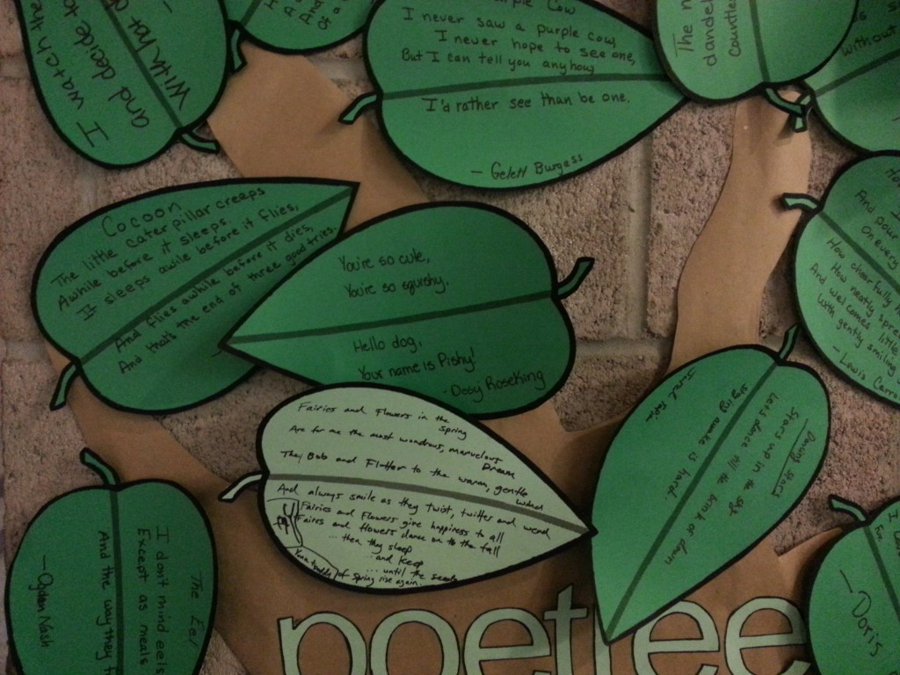
Display the home poems on a poetree
Notes:
Option to display the children’s home poems as a poetree – linking to Nature and Nurture topic.

